Slide 1


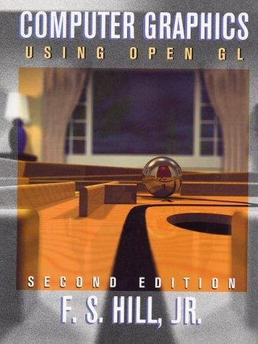
Computer Graphics
new

